Slide 1
Introduction to Quantum Computing: From a Layperson to a Programmer in 30 Steps
Hiu-Yung Wong
https://link.springer.com/book/10.1007/978-3-030-98339-0
https://www.amazon.com/Introduction-Quantum-Computing-Layperson-Programmer/dp/3030983382
Playlist: https://www.youtube.com/watch?v=P9rYlwK0r7I&list=PLnK6MrIqGXsJfcBdppW3CKJ858zR8P4eP&index=1

Slide 2
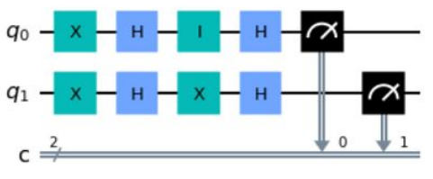
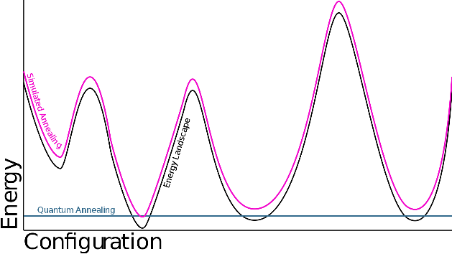
Applications of Quantum Computing
Quantum computing uses two quantum phenomena
Superposition and entanglement and interference
Two major types of quantum computing
Gate-based (this talk)
Quantum annealing (optimization by minimizing energy)
Applications
Material and drug design
Secure communication
Optimization
Finance
Gate Model
Quantum Annealing

Slide 3
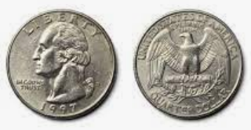
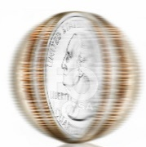

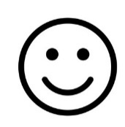

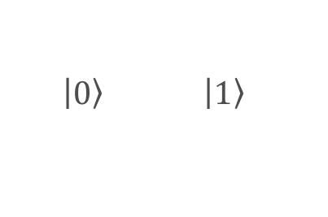



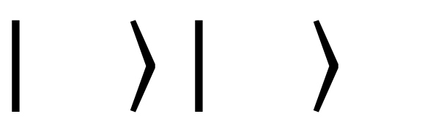

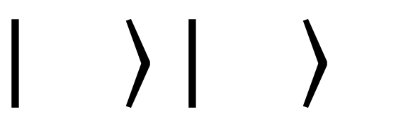
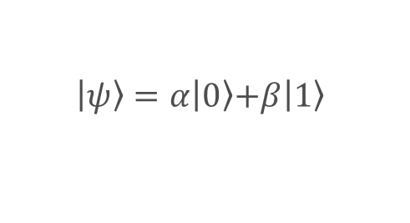
State and Superposition
Classical Computing
Quantum Computing
(basis states)
Quantum Computing with superposition
$$0$$
$$1$$
$\left.\left|0\right.\right\rangle$ $\left.\left|1\right.\right\rangle$
$$\left.\left|ψ\right.\right\rangle =\left.α\left|0\right.\right\rangle \left.+β\left|1\right.\right\rangle$$
$$\left.\left|\right.\right\rangle =α\left.\left|\right.\right\rangle +β\left.\left|\right.\right\rangle$$
Information represented by the states
Quantum computing is powerful because it uses superposition
No difference from classical computing

Slide 4
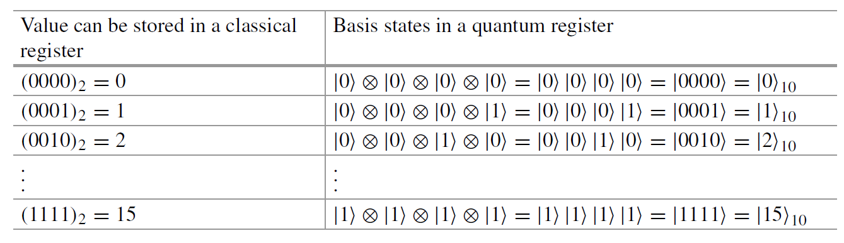
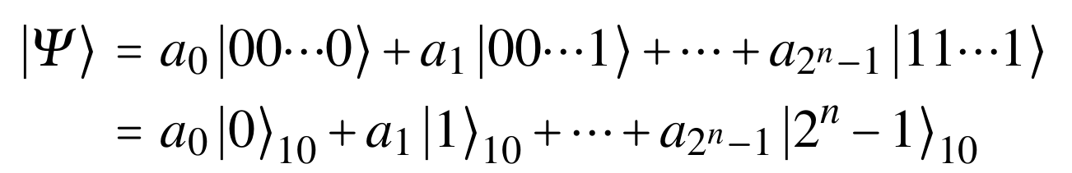
Quantum Registers
Superposition of basis states of multiple qubits

Slide 5
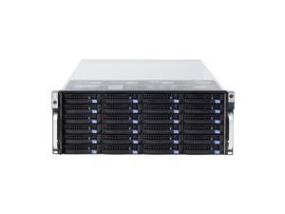
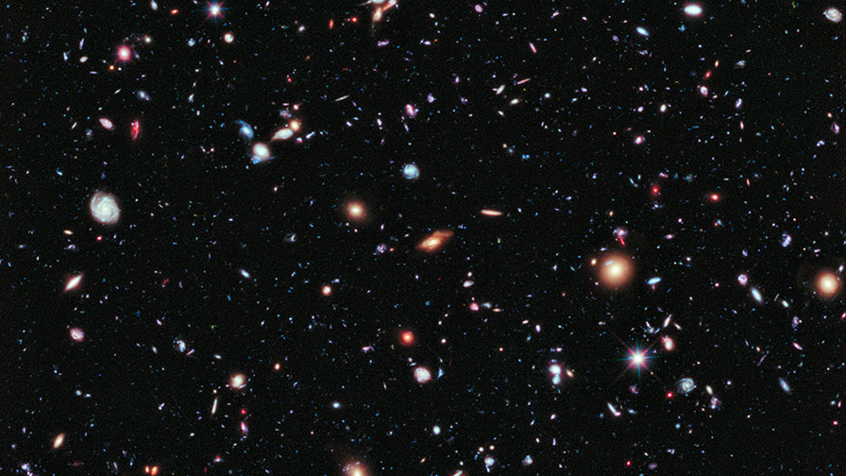
The Power of Superposition
n = 300 (e.g. electrons)
2³⁰⁰ = 10⁹⁰ complex coefficients, a_{i}
Number of atoms in the universe < 10⁸²
Total number of storage in the world < 10²¹ bytes

Slide 6
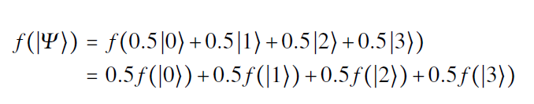
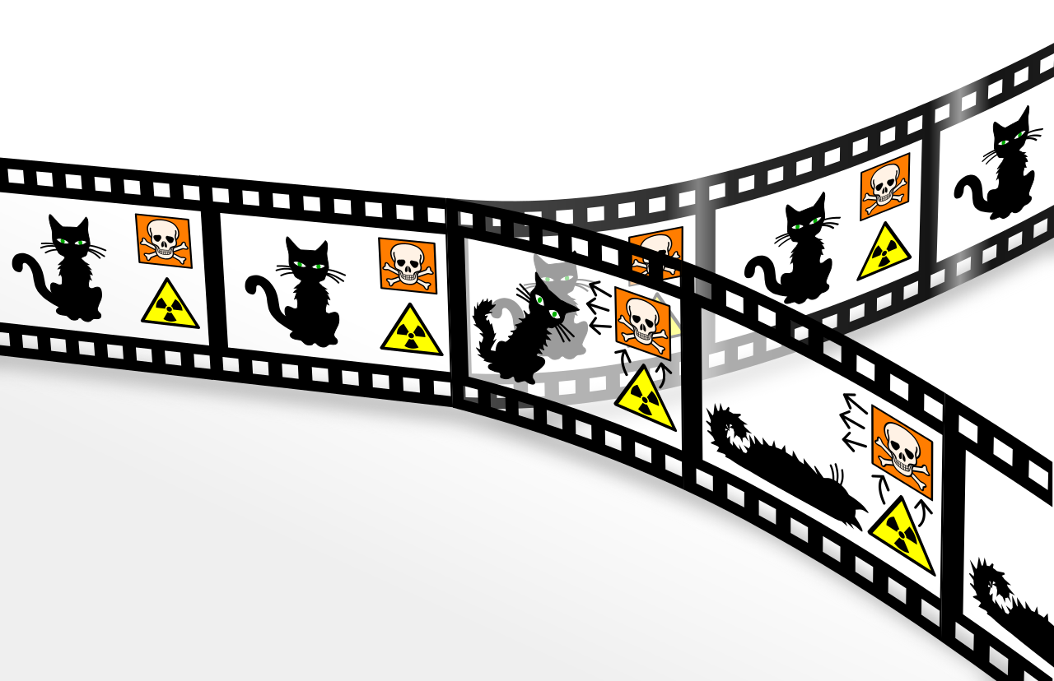

Quantum Parallelism
Linear Quantum mechanics
Wikipedia

Slide 7
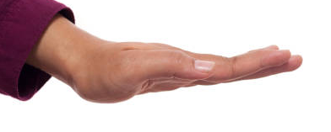








Measurement
$${\left|α\right|}^{2}$$
$$\left.\left|0\right.\right\rangle$$
$$\left.\left|ψ\right.\right\rangle =\left.α\left|0\right.\right\rangle \left.+β\left|1\right.\right\rangle$$
M
$$\left.\left|1\right.\right\rangle$$
$${\left|β\right|}^{2}$$

